Slide 1
CS35L – Winter 2019
Slide set: | 3.1
Slide topics: | Diff, modifying programs
Assignment: | 3

Slide 2
How to Install Software
Windows
Installshield
Microsoft/Windows Installer
OS X
Drag and drop from .dmg mount -> Applications folder
Linux
rpm(Redhat Package Management)
RedHat Linux (.rpm)
apt-get(Advanced Package Tool)
Debian Linux, Ubuntu Linux (.deb)
Good old build process
configure, make, make install

Slide 3

Decompressing Files
Generally, you receive Linux software in the tarball format (.tgz) or (.gz)
Decompress file in current directory:
$ tar –xzvf filename.tar.gz
Option –x: --extract
Option –z: --gzip
Option –v: --verbose
Option –f: --file
Notes:
Tar –czvf

Slide 4
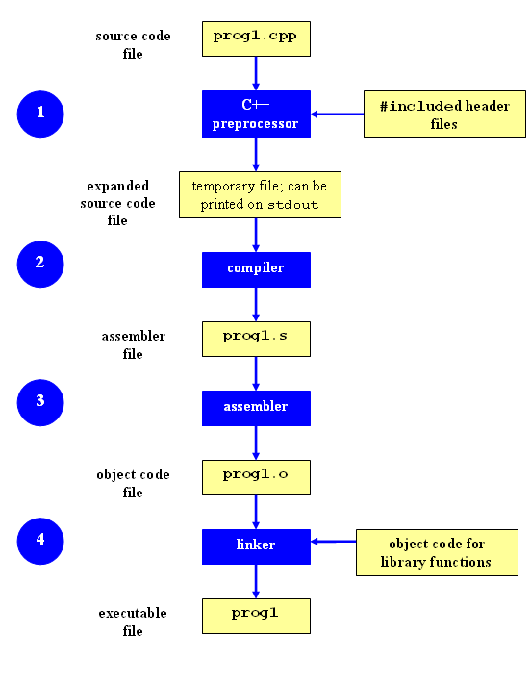
Compilation Process
Notes:
Hi Shivam,
1)The preprocessor handles the preprocessor directives, like #include and #define.
2)It works on one C++ source file at a time by replacing #include directives with the content of the respective files (which is usually just declarations), doing replacement of macros (#define), and selecting different portions of text depending of #if, #ifdef and #ifndef directives.
3)The compiler parses the pure C++ source code (now without any preprocessor directives) and converts it into assembly code.
4)Then invokes underlying back-end(assembler in toolchain) that assembles that code into machine code producing actual binary file in some format(ELF, COFF, a.out, ...). This object file contains the compiled code (in binary form) of the symbols defined in the input.
5)Object files can refer to symbols that are not defined. This is the case when you use a declaration, and don't provide a definition for it. The compiler doesn't mind this, and will happily produce the object file as long as the source code is well-formed.
6)It's at this stage that "regular" compiler errors, like syntax errors or failed overload resolution errors, are reported.
7)The linker is what produces the final compilation output from the object files the compiler produced.
8)This output can be either a shared (or dynamic) library (and while the name is similar, they haven't got much in common with static libraries mentioned earlier) or an executable
1)The preprocessor handles the preprocessor directives, like #include and #define.
2)It works on one C++ source file at a time by replacing #include directives with the content of the respective files (which is usually just declarations), doing replacement of macros (#define), and selecting different portions of text depending of #if, #ifdef and #ifndef directives.
3)The compiler parses the pure C++ source code (now without any preprocessor directives) and converts it into assembly code.
4)Then invokes underlying back-end(assembler in toolchain) that assembles that code into machine code producing actual binary file in some format(ELF, COFF, a.out, ...). This object file contains the compiled code (in binary form) of the symbols defined in the input.
5)Object files can refer to symbols that are not defined. This is the case when you use a declaration, and don't provide a definition for it. The compiler doesn't mind this, and will happily produce the object file as long as the source code is well-formed.
6)It's at this stage that "regular" compiler errors, like syntax errors or failed overload resolution errors, are reported.
7)The linker is what produces the final compilation output from the object files the compiler produced.
8)This output can be either a shared (or dynamic) library (and while the name is similar, they haven't got much in common with static libraries mentioned earlier) or an executable

Slide 5
Command-Line Compilation
main.cpp
#includes cart.h
shop.cpp
#includes lookup_item.h & cart.h
lookup_item.cpp
#includes lookup_item.h
g++ -Wall lookup_item.cpp shop.cpp main.cpp –o shop
Compilation Command
Notes:
-Wall This enables all the warnings about constructions that some users consider questionable, and that are easy to avoid (or modify to prevent the warning), even in conjunction with macros.

Slide 6
Changes to header or source files
Rerun command to generate new executable
But for only a small change?
(For example, a slight modification in lookup_item.cpp)
It isn’t efficient to recompile main.cpp and shop.cpp
Solution: avoid waste by producing a separate object code file for each source file
g++ -Wall –c lookup_item.cpp… (for each source file)
g++ lookup_item.o main.o shop.o –o shop (combine)
Less work for compiler, saves time but more commands

Slide 7
C++ Header Files
C++ classes (and often function prototypes) are normally split up into two files.
The header file has the extension of .h and contains class definitions and functions.
The implementation of the class goes into the .cpp file.
By doing this, if your class implementation doesn’t change then it won’t need to be recompiled.

Slide 8
C++ Header File Example
File: Num.h class Num { private: int num; public: Num(int n); int getNum(); }; File: Num.cpp #include "Num.h" Num::Num() : num(0) { } Num::Num(int n): num(n) {} int Num::getNum() { return num; } File: main.cpp #include <iostream> #include "Num.h" using namespace std; int main() { Num n(35); cout << n.getNum() << endl; return 0; }
Compilation
g++ main.cpp Num.cpp

Slide 9
Changes to a header file
Need to recompile every source file that includes it & every source file that includes a header that includes it.
In this example, changing item.h would affect item.cpp and shop.cpp
Difficult to keep track of files when project is large
Windows 7 ~40 million lines of code
Google ~2 billion lines of code

Slide 10
make
Utility for managing large software projects
Compiles files and keeps them up-to-date
Efficient Compilation (only files that need to be recompiled)

Slide 11
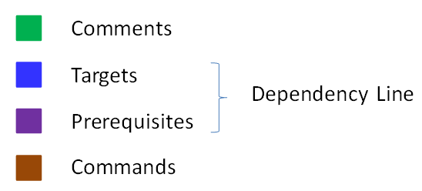
Makefile Example
# Makefile - A Basic Example
all : shop #usually first
shop : lookup_ item.o main.o shop.o
g++ -g -Wall -o shop item.o main.o shop.o
item.o : lookup_item.cpp lookup_item.h
g++ -g -Wall -c lookup_item.cpp
main.o : shop.cpp cart.h
g++ -g -Wall -c main.cpp
shop.o : shop.cpp lookup_item.h cart.h
g++ -g -Wall -c shop.cpp
clean :
rm -f item.o main.o shop.o
Rule

Slide 12
Build Process
configure
Script that checks details about the machine before installation
Resolves dependencies between packages
Creates ‘Makefile’
make
Requires ‘Makefile’ to run
Compiles all the program code and creates executables in current temporary directory
make install
make utility searches for a label named install within the Makefile, and executes only that section of it
executables are copied into the final directories (system directories)
Notes:
1. Configure the software
The configure script is responsible for getting ready to build the software on your specific system. It makes sure all of the dependencies for the rest of the build and install process are available, and finds out whatever it needs to know to use those dependencies.
Unix programs are often written in C, so we’ll usually need a C compiler to build them. In these cases the configure script will establish that your system does indeed have a C compiler, and find out what it’s called and where to find it.
2. Build the software
Once configure has done its job, we can invoke make to build the software. This runs a series of tasks defined in a Makefile to build the finished program from its source code.
The tarball you download usually doesn’t include a finished Makefile. Instead it comes with a template called Makefile.in and the configure script produces a customised Makefile specific to your system.
3. Install the software
Now that the software is built and ready to run, the files can be copied to their final destinations. The make install command will copy the built program, and its libraries and documentation, to the correct locations.
This usually means that the program’s binary will be copied to a directory on your PATH, the program’s manual page will be copied to a directory on your MANPATH, and any other files it depends on will be safely stored in the appropriate place.
Since the install step is also defined in the Makefile, where the software is installed can change based on options passed to the configure script, or things the configure script discovered about your system.
Depending on where the software is being installed, you might need escalated permissions for this step so you can copy files to system directories. Using sudo will often do the trick.

Slide 13
Patching
A patch is a piece of software designed to fix problems with or update a computer program
It’s a diff file that includes the changes made to a file
A person who has the original (buggy) file can use the patch command with the diff file to add the changes to their original file

Slide 14
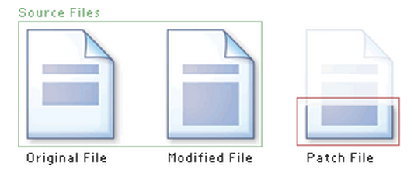
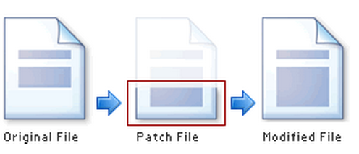
Applying a Patch
patch –pnum < patch_file
‘man patch’ to find out what pnum does and how to use it

Slide 15
diff Unified Format
diff –u original_file modified_file
--- path/to/original_file
+++ path/to/modified_file
@@ -l,s +l,s @@
@@: beginning of a hunk
l: beginning line number
s: number of lines the change hunk applies to for each file
A line with a:
(- sign): was deleted from the original
(+ sign): was added to the original
(): stayed the same

Slide 16
Lab 3
Coreutils 8.29 has a problem
$ la –A is equivalent to ls -a –A
if the current directory has two files named .foo and bar, the command la -A outputs four lines, one each for ., .., .foo, and bar.
These users want la -A to output just two lines instead, one for .foo and one for bar
Why?
the -a option always overrides the -A option regardless of which option is given first
Want the flag that comes later to take effect
Fix the ls program

Slide 17
Getting Set Up (Step 1)
Download coreutils-8.29 to your home directory
Use ‘wget’
Untar and Unzip it
tar –xJvf coreutils-8.29.tar.xz
Make a directory ~/coreutilsInstall in your home directory (this is where you’ll be installing coreutils)
mkdir ~/coreutilsInstall

Slide 18
Building coreutils (Step 2)
Go into coreutils-8.29 directory. This is what you just unzipped.
Read the INSTALL file on how to configure “make”, especially --prefix flag
Run the configure script using the prefix flag so that when everything is done, coreutils will be installed in the directory ~/coreutilsInstall
Compile it: make
Install it: make install (won’t work on Linux server without proper prefix!)
Why?

Slide 19
Reproduce Bug (Step 3)
Reproduce the bug by running the version of ‘ls -a -A ’ in coreutils 8.29
If you just type $ ls at CLI it won’t run ‘ls’ in coreutils 8.29
Why? Shell looks for /bin/ls
To use coreutils 8.29: $ ./ls
This manually runs the executable in this directory

Slide 20
Patching and Building (Steps 4 & 5)
cd coreutils-8.29
vim or emacs patch_file: copy and paste the patch content
patch –pnum < patch_file
‘man patch’ to find out what pnum does and how to use it
cd into the coreutils-8.29 directory and type make to rebuild patched ls.c.
Don’t install!

Slide 21
Testing Fix (Step 6)
Test the following:
Modified ls works
Installed unmodified ls does NOT work
Test on:
Empty directory
Directory containing a hidden file
With just –a, with just –A
With –aA
With –Aa
Answer Q1 and Q2

